Slide 1
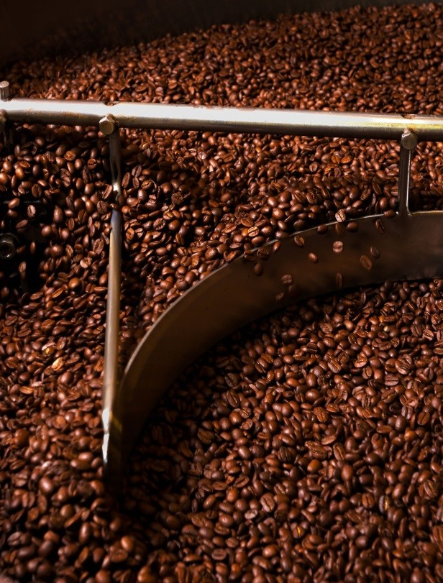

Autonomous Coffee Roasting
Welcome
Machine Teaching for Autonomous AI - Final Project (M3)
Brian G Hannum
Phil, Latte Art Champion 2019, Seasoned Barista

Slide 2
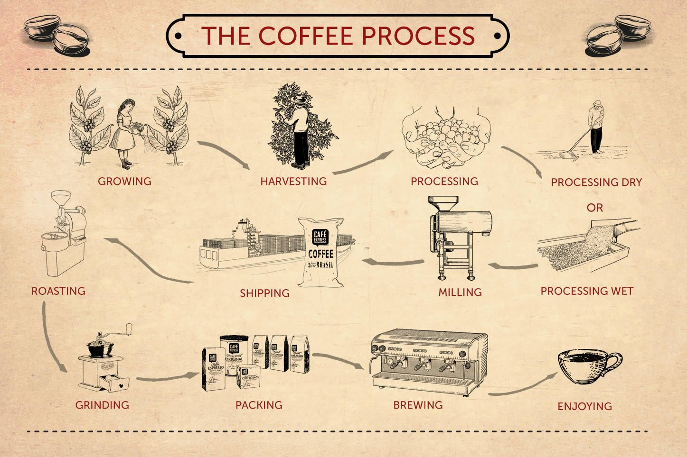

Notes:
Cover basics of Roasting
Green beans vs light/medium/dark

Slide 3
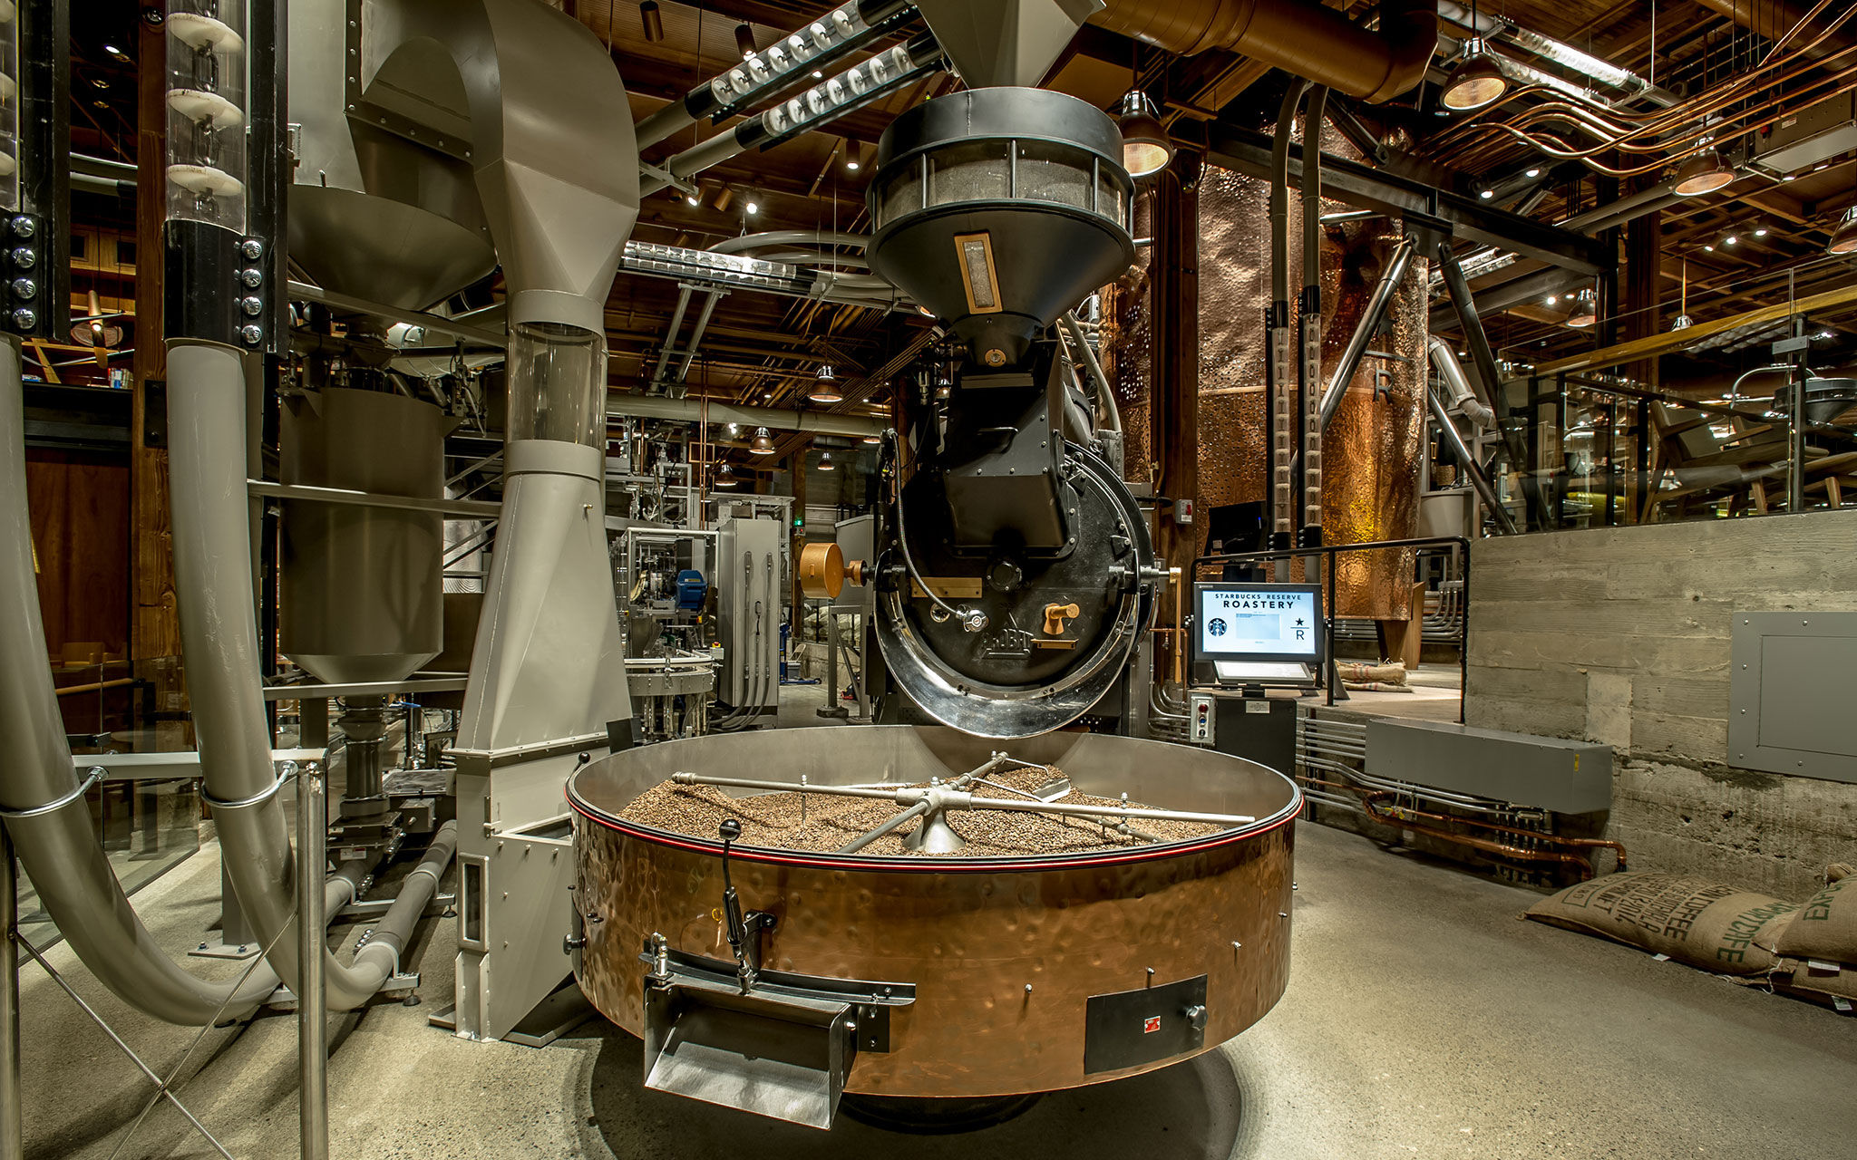

Coffee Roasting with Bonsai – Opportunity
Coffee roasting facilities roast 100-million pounds of coffee each year
Reliance on Master Roasters to regularly check quality and adjust systems
Opportunity to improve first-time quality throughput
“A matter of seconds can mean the difference between a perfect roast, and one that’s not” – Phil
(Actually M. Cohen (Starbucks Coffee Education Specialist))
Notes:
Discuss quote

Slide 4
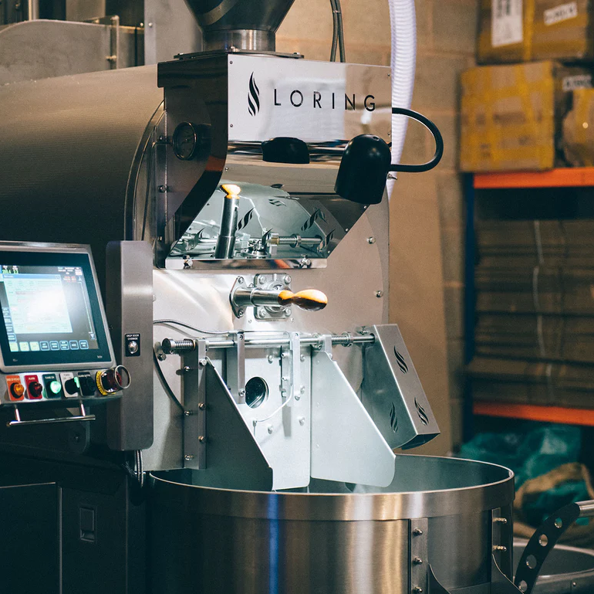
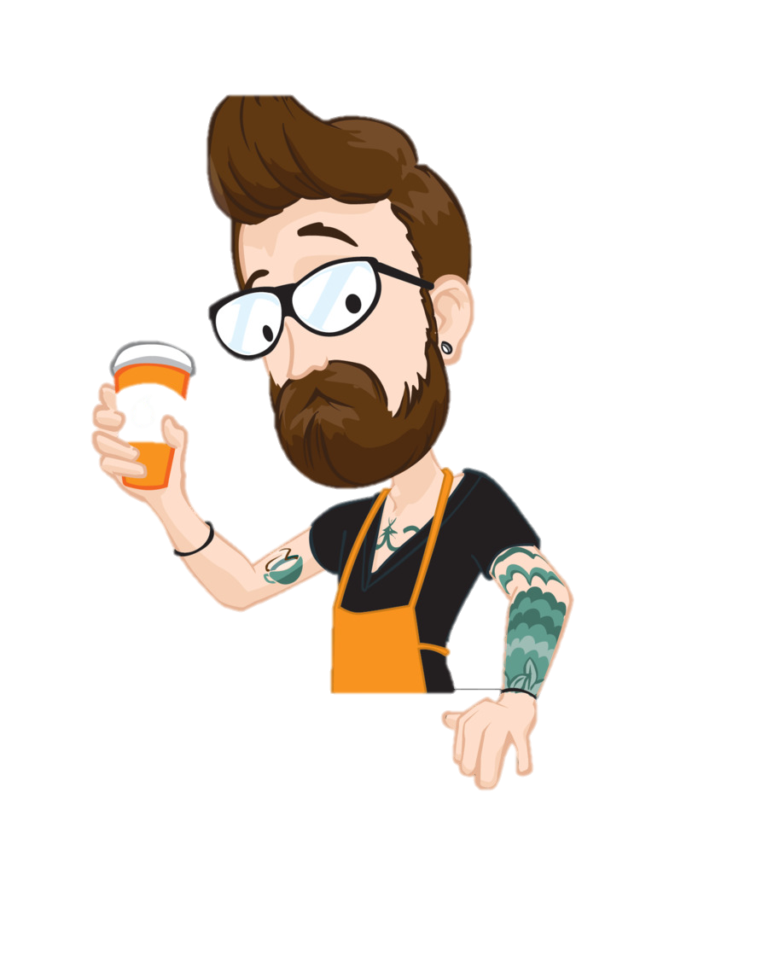
Coffee Roasting with Bonsai – Automation
Plethora of sensing technologies already in use
Low-level PID controllers
Operator knowledge required to program the technologies
Phil, Latte Art Champion 2019, Master Barista, Controls Expert
Notes:
Listen for the ‘crack’

Slide 5

Coffee Roasting with Bonsai – Solution
Deep Reinforcement Learning:
Strategies – Coarse vs Fine
Improved temperature, and time management
Maximize consistency and quality
Machine Learning:
‘Crack’ detection
Predict output quality
Math: PID controllers for low-level control
Notes:
Strategic vs Functional

Slide 6
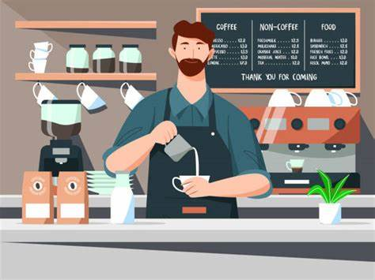
Coffee Roasting with Bonsai – Value
Maximize coffee roast throughput (tons per hour) while maintaining high quality
Improvement in first-time roast quality
Reduction in time changing roast setpoints
Keep the process in specification
5% throughput improvement yields an ROI of $1.2M / year at a roast plant
Look at that smile
Notes:
Large scale coffee plants can roast/produce 1.5 million pounds of coffee per week. At ~$15/lb of coffee, improving production to remove losses due to unidentified equipment faults, incorrect control to changing conditions, inexperienced operators, or non-optimized processes, improving throughput by 5% would generate a projected return on investment of $1.2M / year at a given plant.
Improvement in quality = reduction in waste!

Slide 7
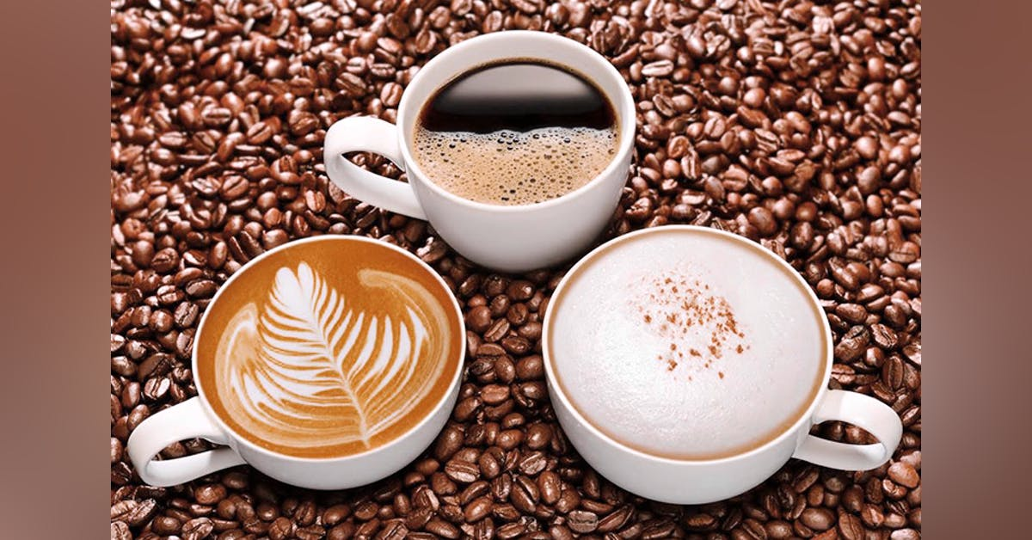
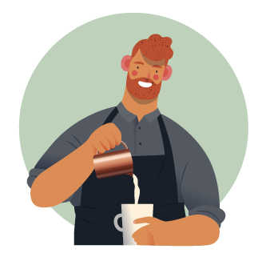
Thanks for tuning in!

